Slide 1
Cash as a Social Impact Asset Class
Is there really that much cash to worry about?
Total deposits at U.S. banks are at an all-time high of over $14 trillion*
Includes $5T in money market accounts and $3T in savings accounts
Less than 1% of these funds are in socially impactful options
Cash doesn’t just sit at a bank; it’s active – the question is whether it’s working to strengthen the causes, values, and organizations you support or serve in neutral or (even worse) contradictory positions.
* Source: http://www.bankregdata.com/

Slide 2
Stakeholder Questions
Why do impact investors ignore the potential social benefits and continue to put their cash in traditional banks and money market funds?
Why do corporations making public “cause” announcements but continue to do likewise with their corporate treasuries?
How can local governments and pension funds chase returns through riskier corporate paper when comparable financial returns can be achieved through options that benefit their very communities?
How can foundations, endowments, and nonprofits ignore options that can directly support the causes they champion in favor of solutions that may even advocate against causes they care about or deliver worse returns?

Slide 3
The Prevailing Wisdom
Why is cash ignored in the social impact investment portfolio?
Equities are sexier than cash (ESG in public securities is a focus)
Special projects (PRI’s, loans, direct investments) garner more attention
More convenient for CFO’s just to check the money market box or continue to work with their current large bank
Fear of selecting new solutions that carry perceived greater risk
Lack of awareness of the misalignment between deposits and mission
What are the solutions to help us break from the status quo?

Slide 4
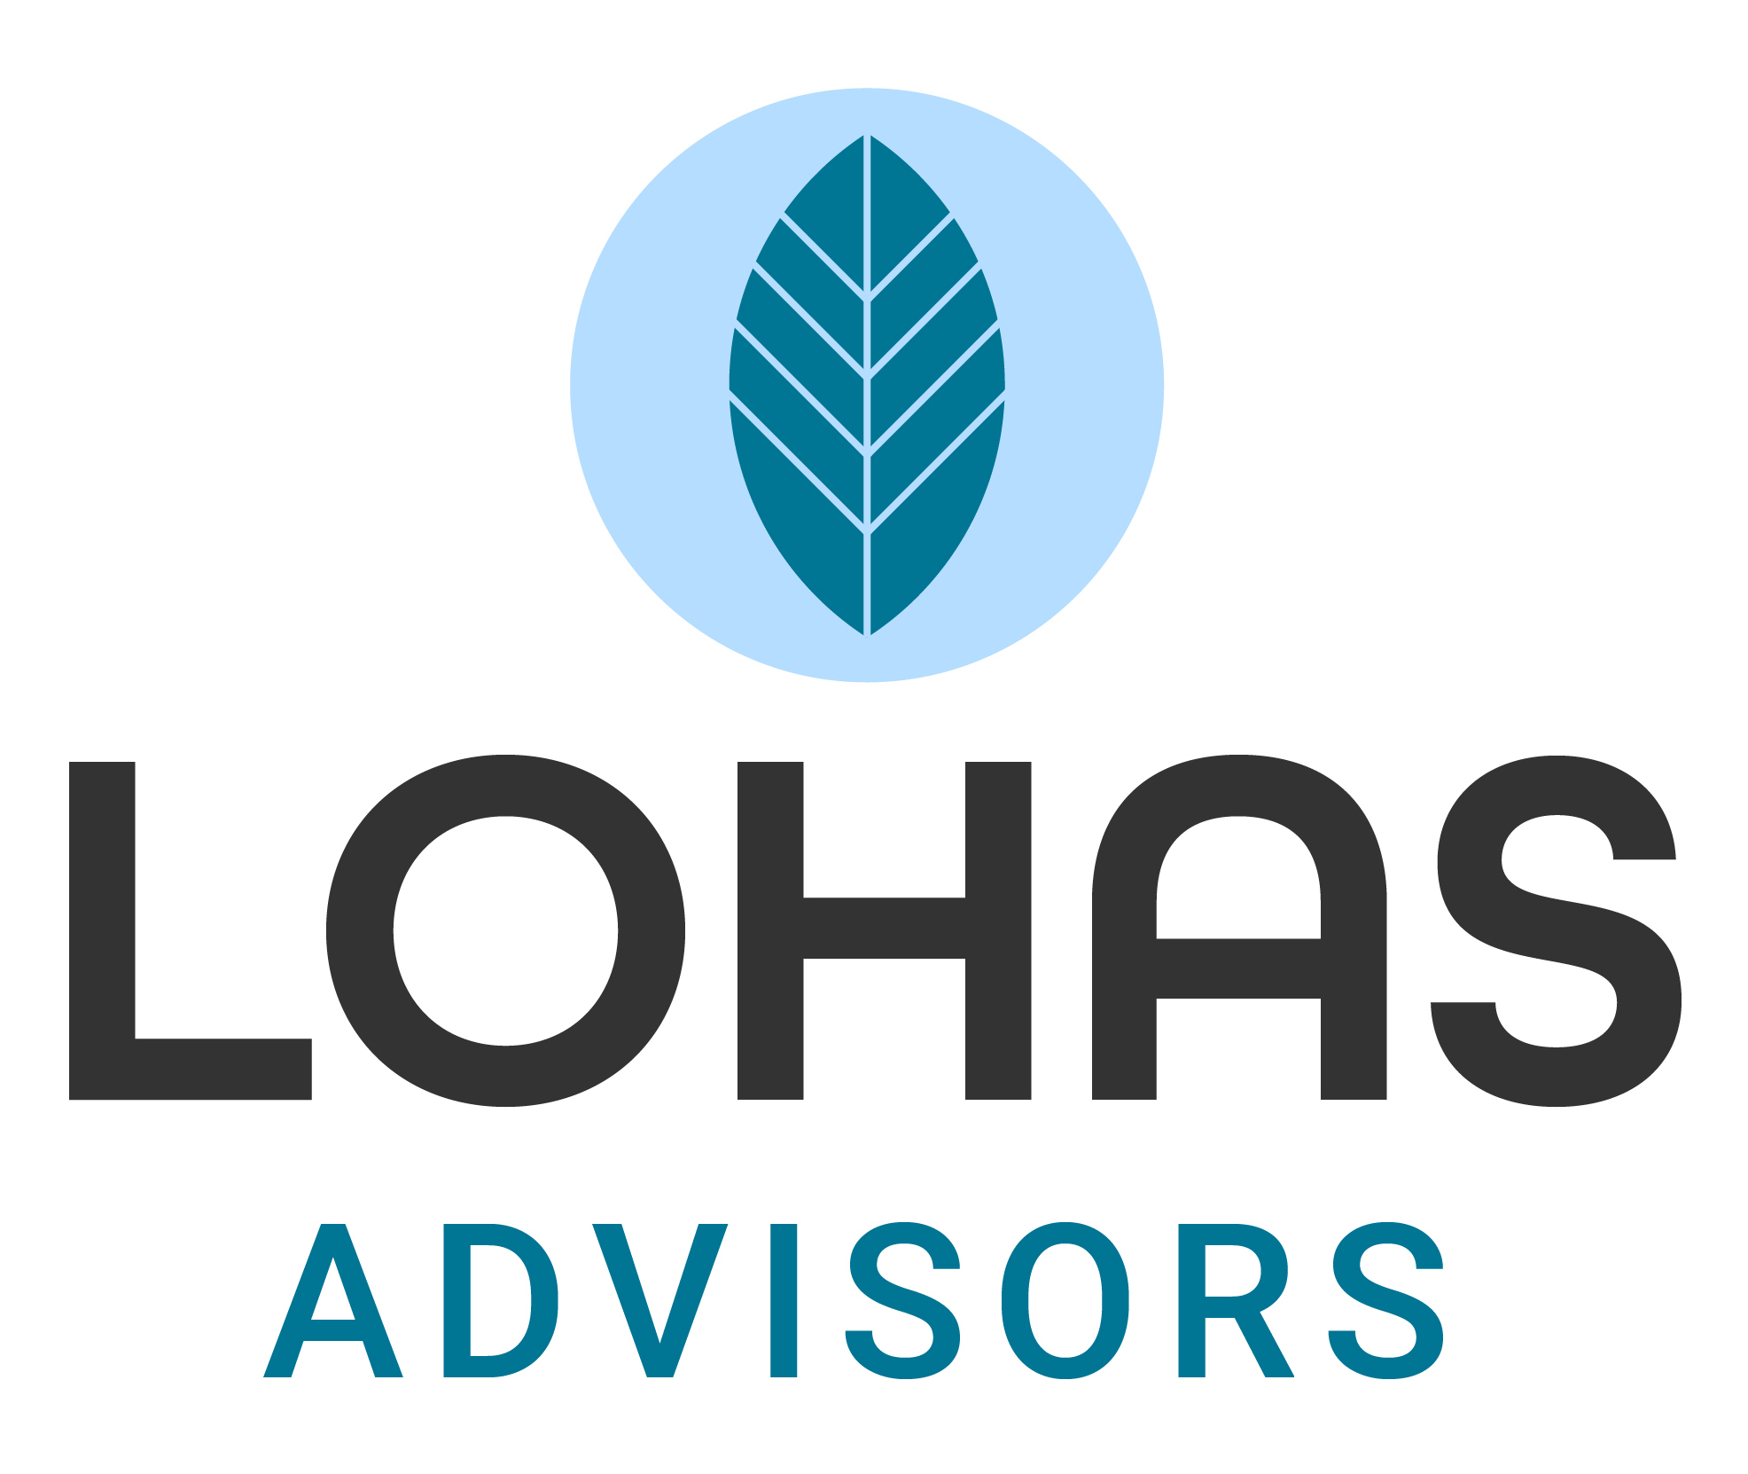
LOHAS Advisors - Cash Option Analysis
LOHAS Advisors provides social impact investment advisory services directly to family offices, high net worth individuals, corporations, foundations, and the wealth/asset managers that support these parties. Leveraging donor advised funds (“DAFs”) and other impact investing strategies, LOHAS Advisors empowers individuals and organizations to generate the impactful outcomes they desire.
Focus of Impact Cash Research
What are the impediments? How do we scale and overcome inertia?
How do we find the best product/solution fits for depositors?
How do we best convey the variations along the impact spectrum?
How can parties better align their deposits with their mission?

Slide 5
Cash Option Considerations
Evaluation Points
FDIC insurance
Liquidity window
Interest rates
Size of deposit
Frequency of withdrawals
Impact Criteria
Mission-based organization?
Place-based vs. specific charitable interests
Tangible ($) as well as intangible benefits to the community

Slide 6
Some Cash Options in the Market
CDFIs*
CDC Deposits
As referenced in GreenMoney Journal article, November 2019: Cash Deposits Can Have a Meaningful Impact on Communities (https://greenmoney.com/cash-deposits-can-make-a-meaningful-impact-on-communities/)
(+)
GABV Banks*
Community Impact
Promontory (CDARS/ICS)
Traditional Banks*
Interest Rates
(-)
Traditional Money Market Funds*
* FDIC insurance limited to $250K

Slide 7
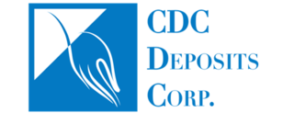
CDC Deposits
Impact Deposit Program
Full FDIC insurance on large cash deposits ($250K+)
Superior interest rates (vs. most money market funds)
Next-day liquidity
Online account access
No account setup or transaction fees
Over $1 billion in deposits under management
Articles of Incorporation: “The sole primary purpose of the Corporation is to develop and deliver programs that improve economic and social outcomes for people in the communities we live and work in especially through programs that link community banks with charitable organizations in the communities which they serve…”
CDCdeposits.com

