Slide 1
LOHAS Advisors Thought Leadership Webinar Series
Impact Investing Insights for Family Offices, High Net Worth Individuals, Foundations, Corporations, and their Advisors

Slide 2
The Healthcare Fund of the Future is Here:
Woman-Founded
Woman-Led
Investing in Women Healthcare Innovators
This presentation does not represent an offer to sell or a solicitation of an offer to buy any security. Any such offer must be made pursuant to a private placement memorandum or other definitive legal documentation prepared by the fund manager (the “Offering Documents”). Securities described in the Offering Documents will be offered through Bequia Securities, LLC: a registered broker dealer, Member FINRA/SIPC, 22 Mill Street, Suite 303, Arlington, MA 02476. Only individuals and entities qualifying as “accredited investors” as defined by the SEC are allowed to invest in these Securities. Potential investors in the fund should carefully consider the risk factors contained in the Offering Documents before making an investment.

Slide 3
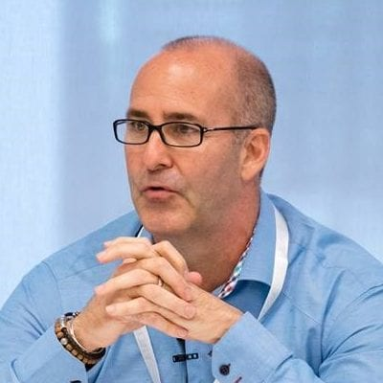
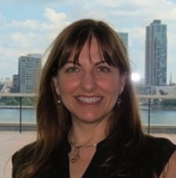
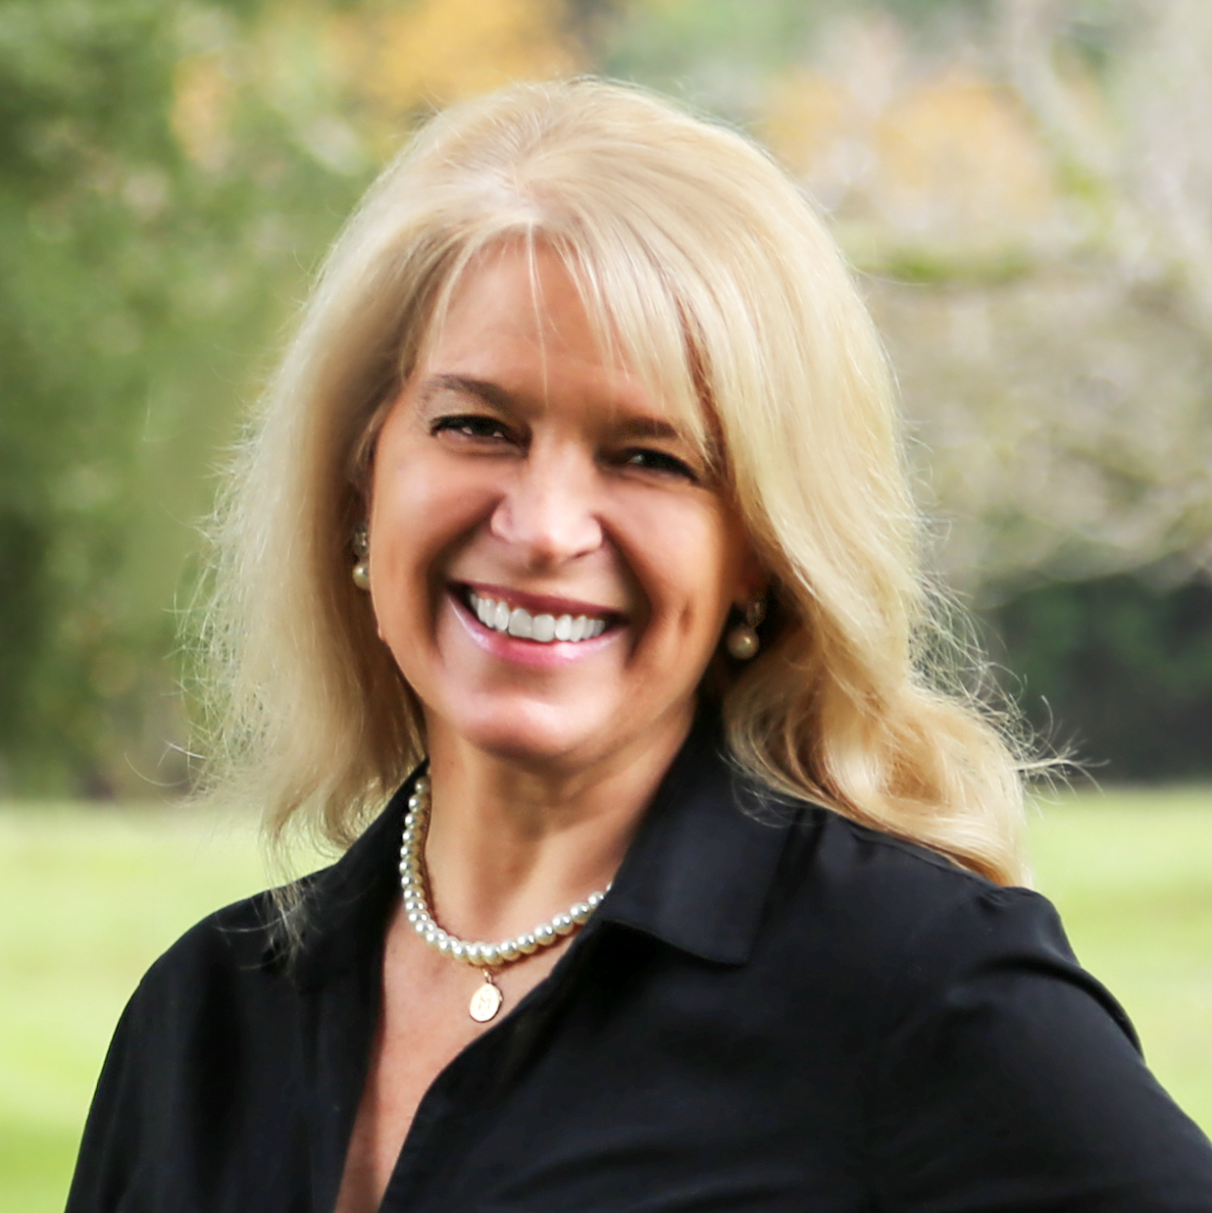
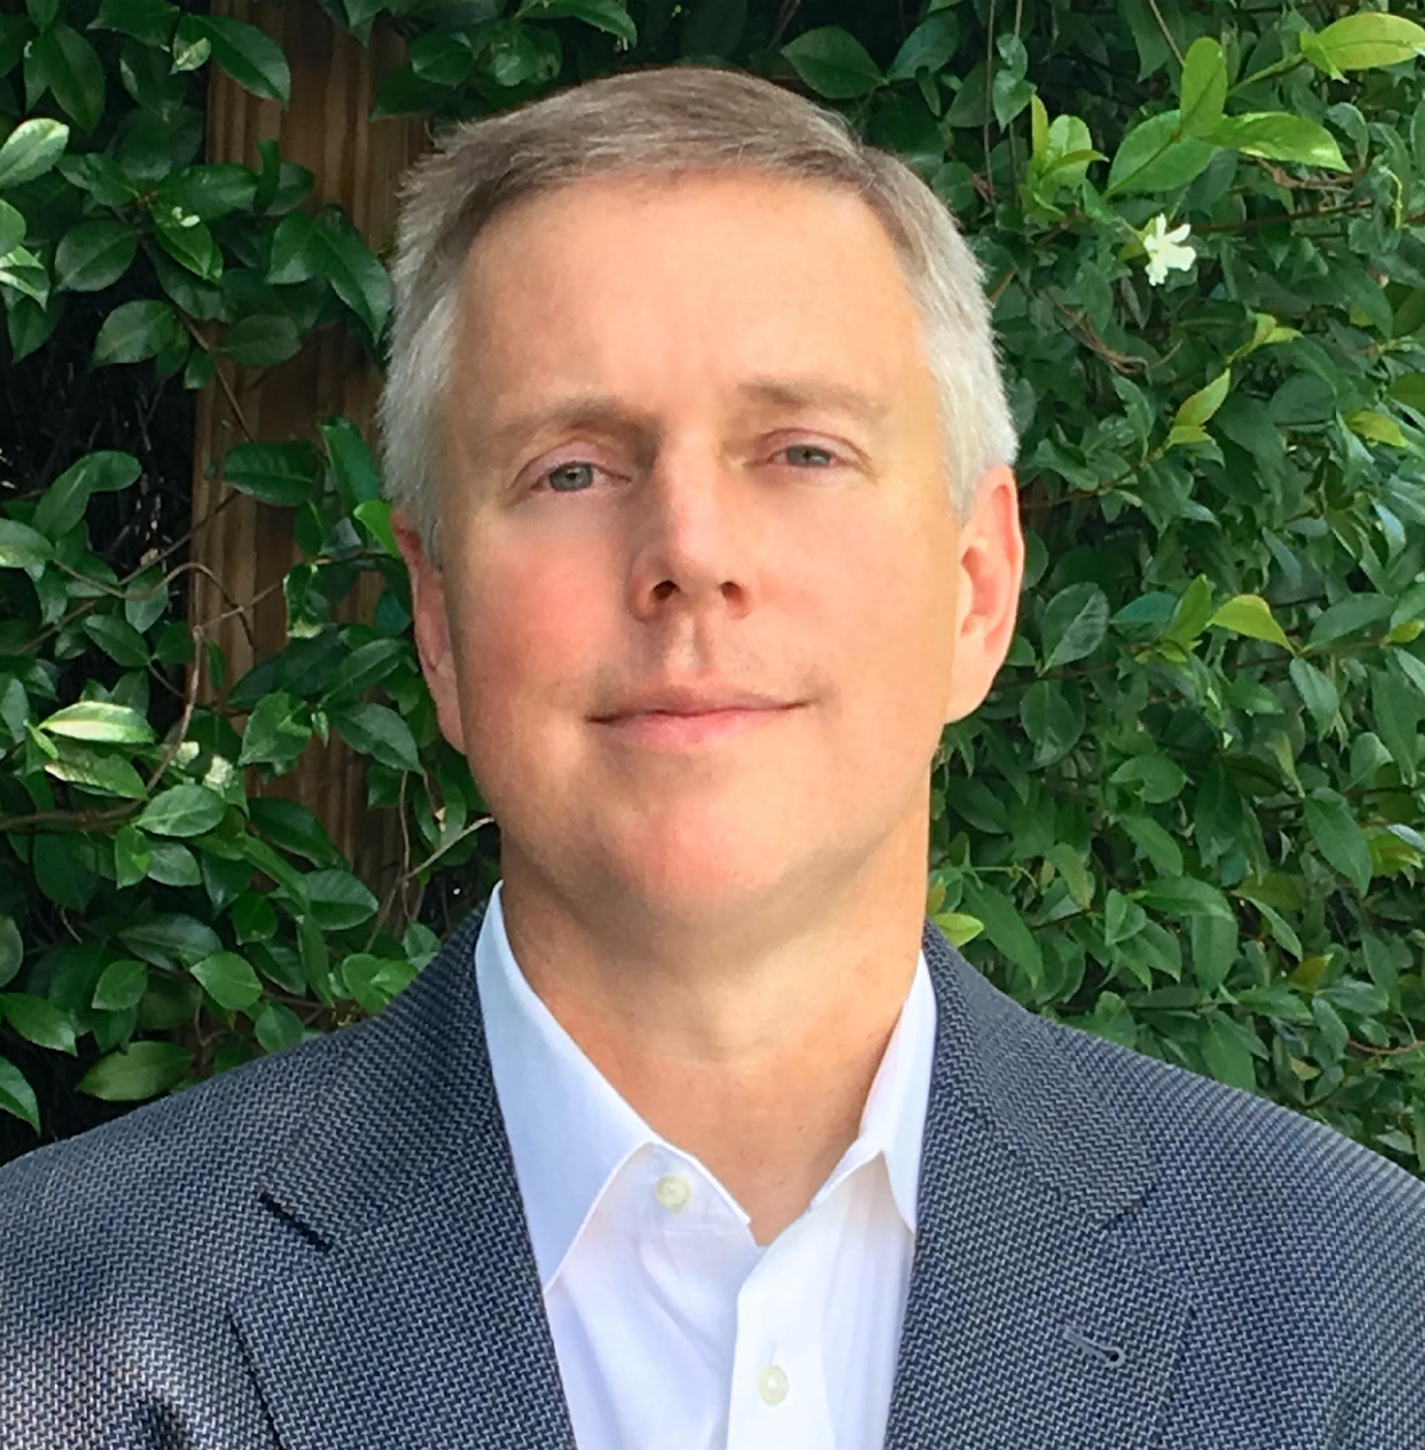
Moderators/Panelist
Dan Hughes
Partner,
LOHAS Advisors
Tami Kesselman
Partner,
LOHAS Advisors
Michele Colucci
Fund Manager,
DigitalDx Ventures
Rick Davis
Partner,
LOHAS Advisors

Slide 4
Webinar Structure
Target: 50 minutes
Educational Focus
Q & A
Access/Contact Details

Slide 5
Agenda
Introduction of Webinar
FO/PW Investor Trends – Tami Kesselman
About – Michele Colucci & DigitalDx Ventures
Health AI and Digital Health Markets
Healthcare Fund of the Future – Examples of Success
Q & A
Next Action Items

Slide 6
Impact Investing and the Family Office
Tami Kessleman
Partner, LOHAS Advisors
Harvard Kennedy School, MPA and Member Global Alumni Board of Directors
Chair, Opal Family Office Investing Forum
NEXUS Impact Investing Steering Committee
Worldwide President, Harvard Alumni in IMPACT

Slide 7
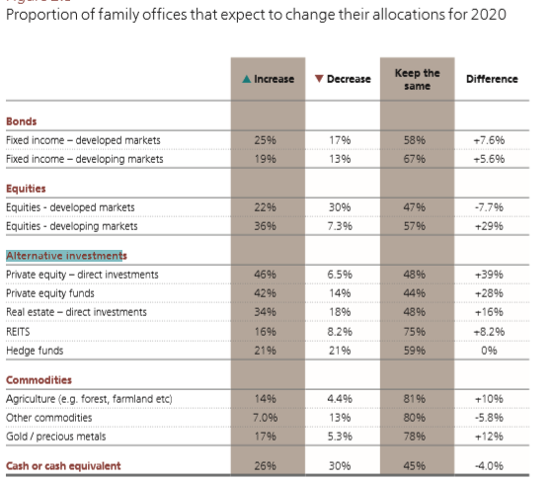
FO/PW Investor Trends
42% plan to increase Alternative Investments in Private Equity Funds in 2020
* 2019 Camden Family Office Report

Slide 8
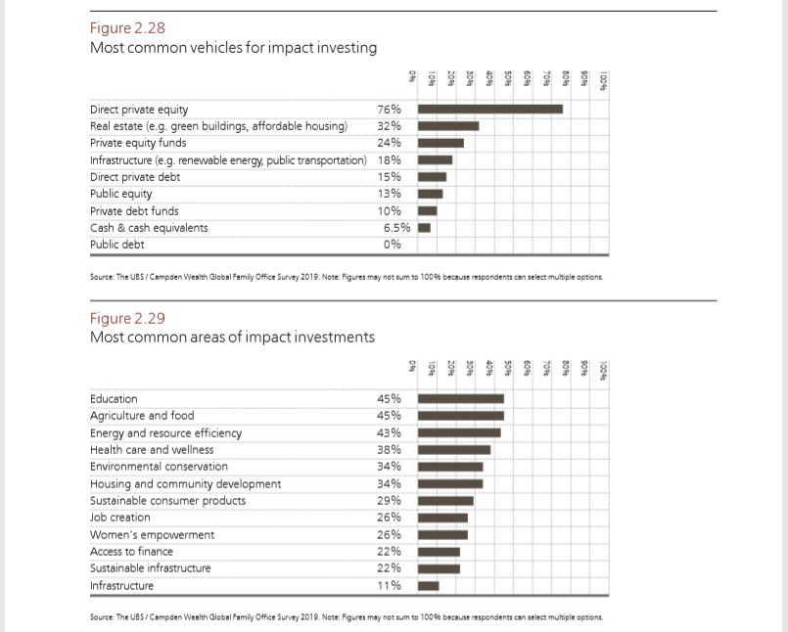
FO/PW Investor Trends
24% preferred PE Funds for impact investing and 38% demonstrated an interest in Healthcare and Wellness
* 2019 Camden Family Office Report

Slide 9
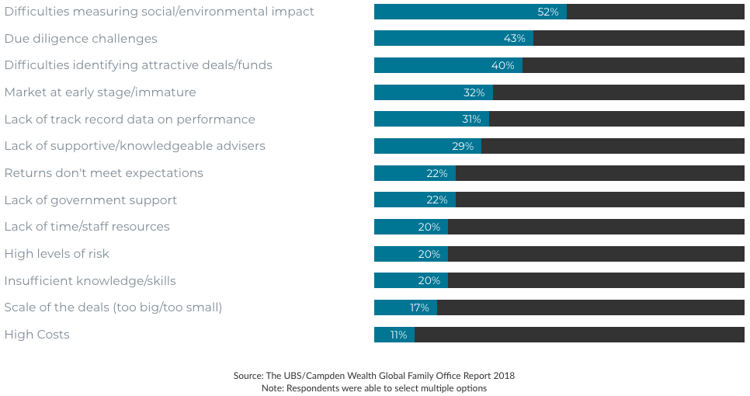
FO/PW Investor Challenges

Slide 10
Attractive Fund Attributes
Numerous studies show that first-time venture / private equity funds and fund managers perform better, on average, than non-first-time funds/managers
Companies with woman founders and/or executive leaders perform better, on average, than companies lacking such gender diversity, and by extension, funds that seek to invest in such diverse companies perform better than funds that do not (Note “Gender Lens as a Winning Strategy in Impact Investing” – GreenMoney Journal, April 2020)

Slide 11
Today’s Panelist
Michele Colucci, Esq.
Co-Founder & Managing Partner
Georgetown Law, JD
Georgetown, BA
Silicon Valley Woman of Influence
Serves on boards of public and private companies
Nobel Laureate Foundation Ambassador

Slide 12
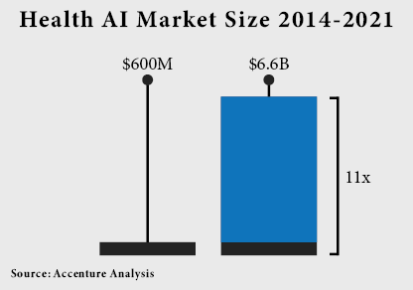
AI & Digital Health

Slide 13
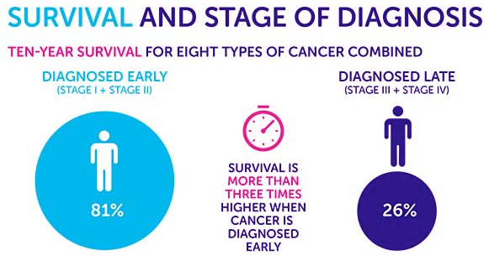
Early Diagnostics

Slide 14
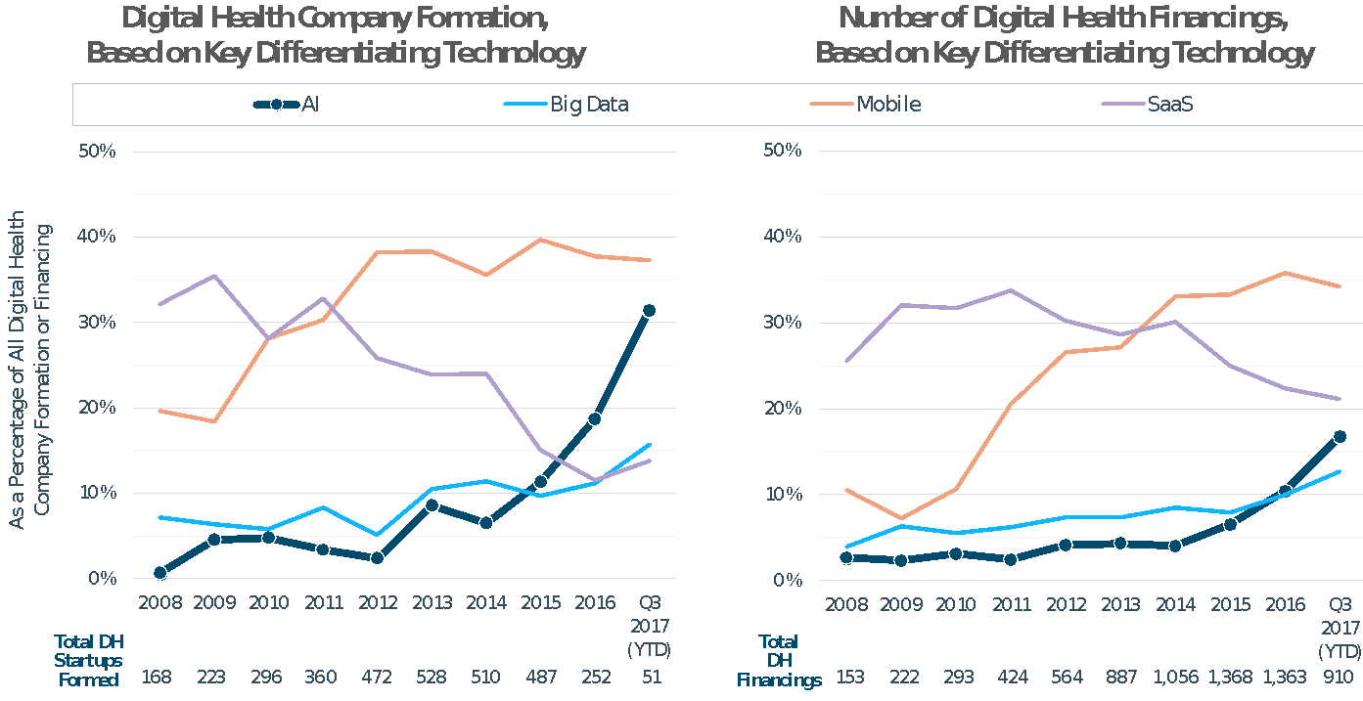
AI & Big Data in Digital Health
A Healthcare Inflection Point

Slide 15
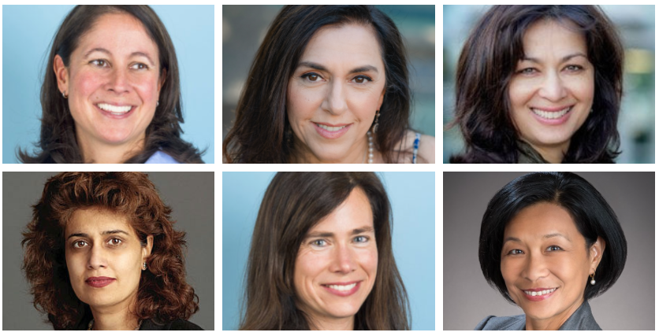
Investing in Women Leaders

Slide 16
Investing in Women Leaders
Founder and CEO of Mental Health Diagnostics Platform
CSO and COO of Alzheimer’s Diagnostics Company
CFO of Brain Health Diagnostics Company
Founder of Kidney Health Diagnostics Company
CIO of Health Diagnostics Company
Seasoned Healthcare Executive

Slide 17
Health AI Market
Artificial Intelligence makes
personalized treatment possible
84% of industry leaders think artificial intelligence will soon transform healthcare
The healthcare AI-powered tools market will exceed $34 billion by 2025
The number of active AI startups has increased 14-fold since 2020
Source: Digital Authority Partners

Slide 18
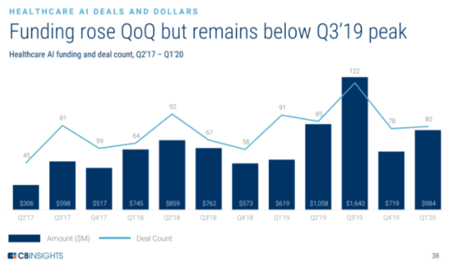
Healthcare AI Funding

Slide 19
DigitalDx Ventures
Investing in Solutions that Diagnose Illnesses Earlier, More Accurately, and Less Invasively, using Artificial Intelligence and Big Data

Slide 20
Examples of Fund Vision
Detecting Alzheimer’s Disease in Eye Scans
First Alzheimer’s diagnostic to receive FDA Breakthrough designation
90% accuracy; shows results not visible by conventional imaging
Multi-spectral imaging of retina produces 1 gig of data per person
Applies machine learning to farm data for insights on brain health
Alzheimer’s and dementia spending is $800B globally, with a $12.5B global screening market
No accurate early diagnostic; current tests only 60%-70% accurate with 25% false positives and 39% false negatives
Recently closed next round of funding at substantial valuation increase

Slide 21
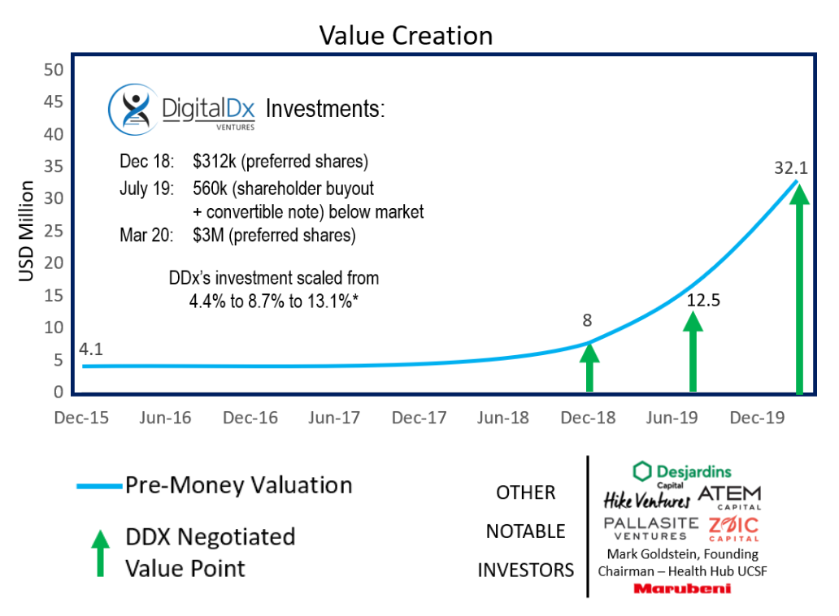
Examples of Fund Vision
LEAD INVESTOR: DDx led the round
SERIES A: $15M, closed Mar 16, 2020
DEAL TERMS: DDx negotiated super pro-rata rights, Board & Observer seats
UNIQUE OPPORTUNITY: DDx limited partners offered direct side-car investment opportunity to to meet demand

Slide 22
Video Inserted Here

Slide 23
Examples of Fund Vision
Diagnosing Kidney Health in Urine
Non-invasive urine test with accuracy in 98th percentile
Alternative to current diagnostics that require drawing blood and have much lower accuracy
Diagnoses kidney transplant rejection, kidney health, and other kidney related diseases
1 in 10 people affected globally (830M); annual spend of ~$114B for CKD and ESRD in the U.S., with $5B screening market size
Kidney injury is treatable but usually asymptomatic until later stages when it’s no longer reversible
High-growth company beginning to raise next round at substantial valuation increase with initial investors already identified

Slide 24
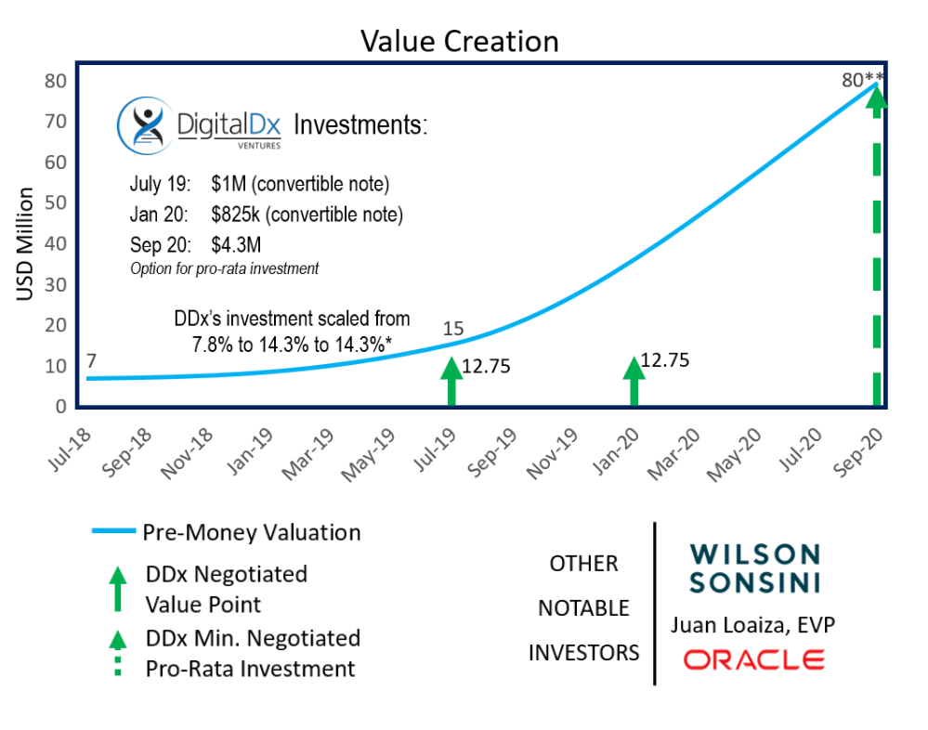
Examples of Fund Vision
SERIES A: Q3 2020; plan to raise $30M - $40M on a currently estimated $80M pre-money valuation
DEAL TERMS: DDx negotiated pro-rata rights, Board & Observer seats
UNIQUE OPPORTUNITY: DDx first institutional money in; rights to lead round; significant discount and cap to next round

Slide 25
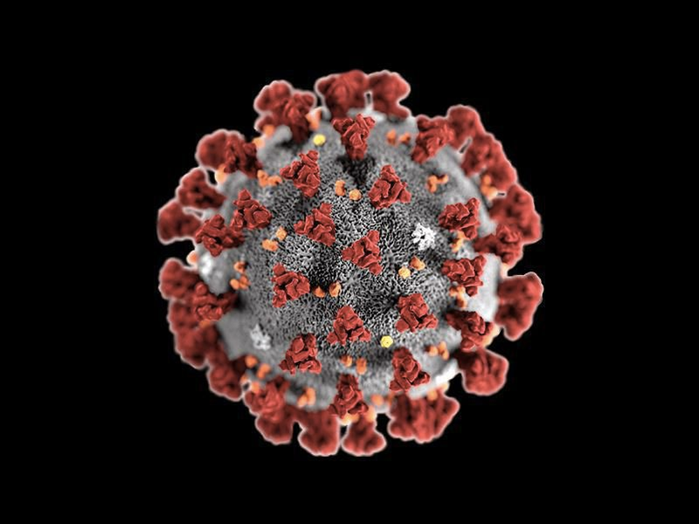
Fund Portfolio and COVID-19

Slide 26
Q & A
Dan Hughes
Partner,
LOHAS Advisors
Tami Kesselman
Partner,
LOHAS Advisors
Michele Colucci
Fund Manager,
DigitalDx Ventures
Rick Davis
Partner,
LOHAS Advisors
Any additional questions? Contact Rick@LOHASadvisors.com

Slide 27
For additional information on DigitalDx Ventures or its portfolio companies, visit DigitalDxVentures.com or contact jared.gonsky@bequiasecurities.com
To stay informed about or share your interest in future social and environmental impact investment opportunities and strategies, please reach out to us at LOHASadvisors.com
This presentation does not represent an offer to sell or a solicitation of an offer to buy any security. Any such offer must be made pursuant to a private placement memorandum or other definitive legal documentation prepared by the fund manager (the “Offering Documents”). Securities described in the Offering Documents will be offered through Bequia Securities, LLC: a registered broker dealer, Member FINRA/SIPC, 22 Mill Street, Suite 303, Arlington, MA 02476. Only individuals and entities qualifying as “accredited investors” as defined by the SEC are allowed to invest in these Securities. Potential investors in the fund should carefully consider the risk factors contained in the Offering Documents before making an investment.

